Slide 1

Environmental Politics of Kazakhstan

Slide 2
The aim
To analyze the existing state of the natural environment of Kazakhstan
Review the concept, strategy and practical tasks of sustainable development

Slide 3
Main questions and brief content:
Processes of destabilization of the natural environment in the Republic of Kazakhstan, causes and consequences;
Ecological problems of Kazakhstan
Provision of sustainable development of Kazakhstan. Strategy of sustainable development and mechanisms of providing sustainable development of Kazakhstan
Legislation of Kazakhstan in the area of environmental protection;
Ecological code of Republic of Kazakhstan.
Main strategic directions of Kazakhstan to improve the environment
Basic Principles of Environmental Protection

Slide 4
CAUSES
Processes of destabilization of the natural environment in the Republic of Kazakhstan

Slide 5

Oil Productions

Slide 6
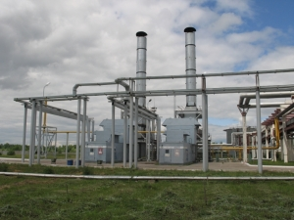
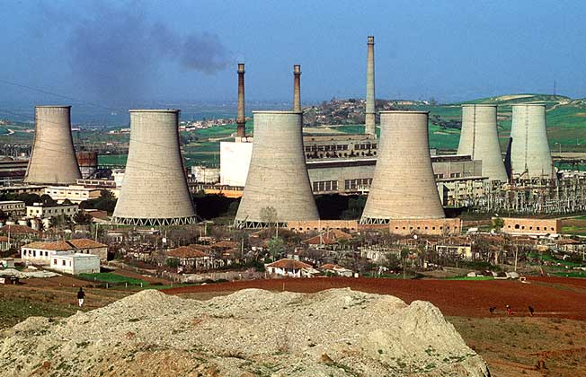
Numerous of electric power plants and heating plants occupying large areas

Slide 7
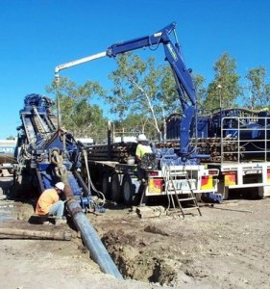
Uncontrolled construction of earth roads to drilling units leads to rapid soil erosion at the roadside

Slide 8
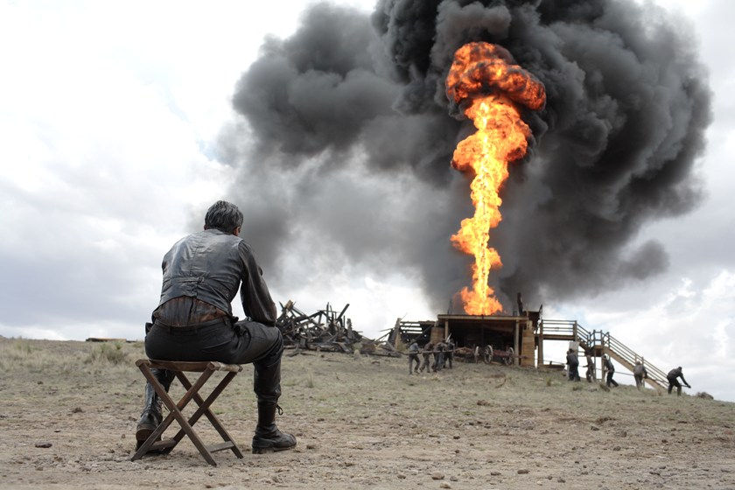
Natural gases are burnt in flares in oil-wells pollution the atmosphere by products of incomplete hydrocarbon combustion

Slide 9

Enterprises of ferrous and non-ferrous metallurgy consume large quantities of water

Slide 10

Large quantities of sulphuric acid are used to produce mineral fertilizers which are discharged in the environment with industrial waste

Slide 11
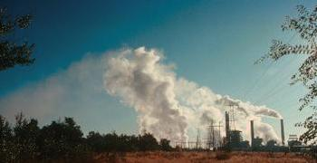
The largest ecological damage is caused by emissions of gaseous matters contaminating the atmosphere

Slide 12
CONSEQUENCES
Processes of destabilization of the natural environment in the Republic of Kazakhstan

Slide 13
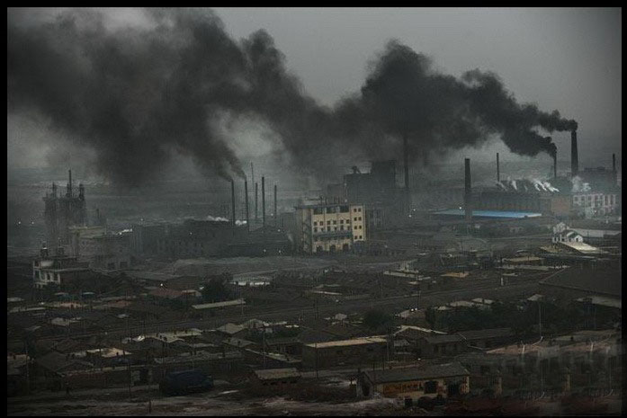
Electric power plants and heating plants pollute the atmosphere

Slide 14

soil with gases and dust to a greater extent, exert harmful impact on flora and fauna

Slide 15

As a result of the violations the atmospheric air is contaminated by defloration of mined and waste ore, the increased disease incidence among workers and local population

Slide 16
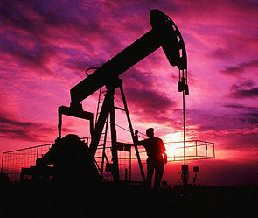
When producing oil the level of underground and ground water decreases

Slide 17


Surface and underground water is contaminated with oil, and then contaminated water flows to water bodies consumed by the population

Slide 18
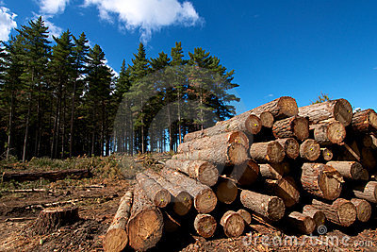
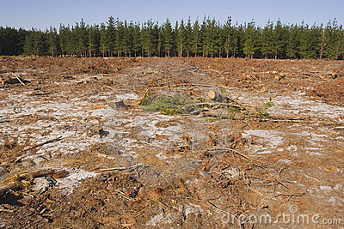
The change in the top soil takes place due to felling forests, thinning out thickets of haloxylon and bottom-land forests

Slide 19
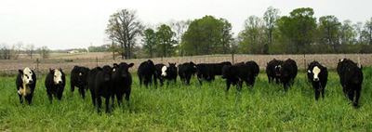
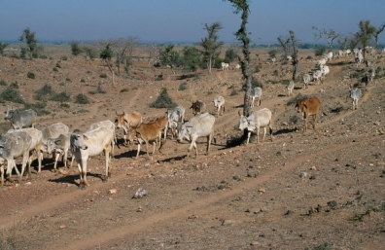
Overgrazing of cattle caused heightened soil erosion and processes of desertification

Slide 20
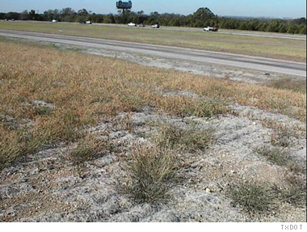
Consequences of human activities as wind and water erosion, contamination of soil by domestic and industrial waste contribute to contamination of the environment

Slide 21
ECOLOGY OF KAZAKHSTAN

Slide 22
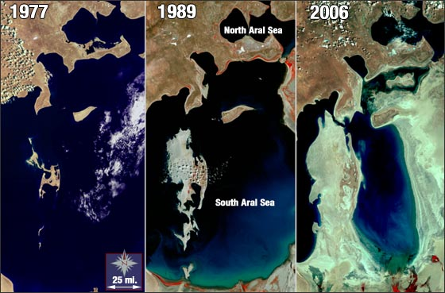
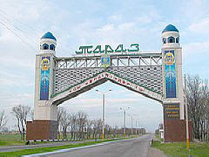
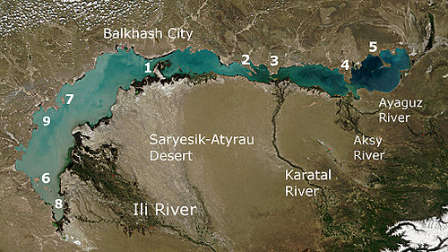
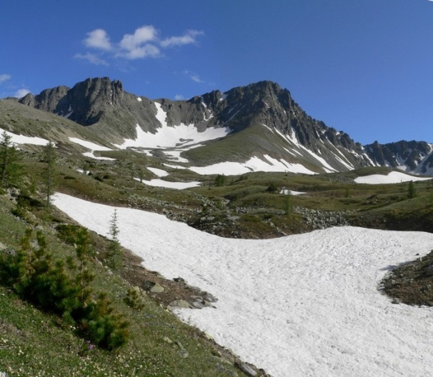
Aral sea, Balkhash Lake, Rudny Altai, the Irtysh River, the Caspian Sea, Almaty city, Zhambyl city, Shymkent city and others

Slide 23

The problem of radiation pollution is still pressing and urgent

Slide 24

Radioactive matters spreading by a food chain

Slide 25
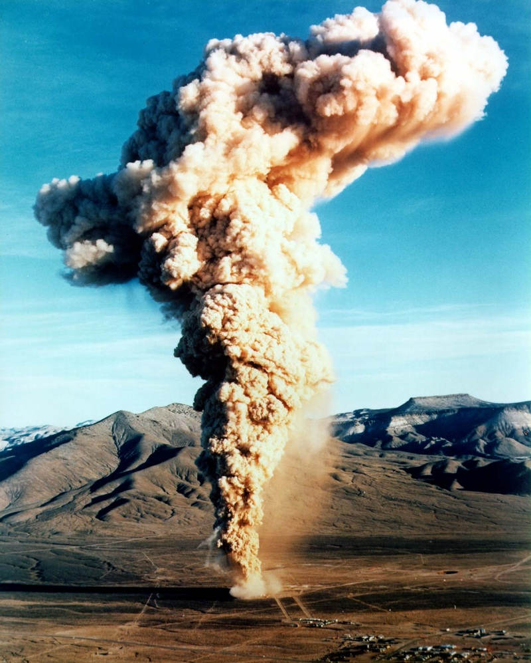
Nuclear weapon tests may be qualified as a very serious crime against the nature and mankind

Slide 26

The number of people who died from leucaemia makes up tens thousand of people

Slide 27
Factors that form a radioecological situation in the country:
The activities of the former Semipalatinsk nuclear site;
Nuclear explosions for the purposes of solving business tasks;
Enterprises of nuclear and industrial complexes;
Mining and processing complex ores, oil and gas with high radioactivity

Slide 28

The condition of water resources is unfavorable in Kazakhstan

Slide 29
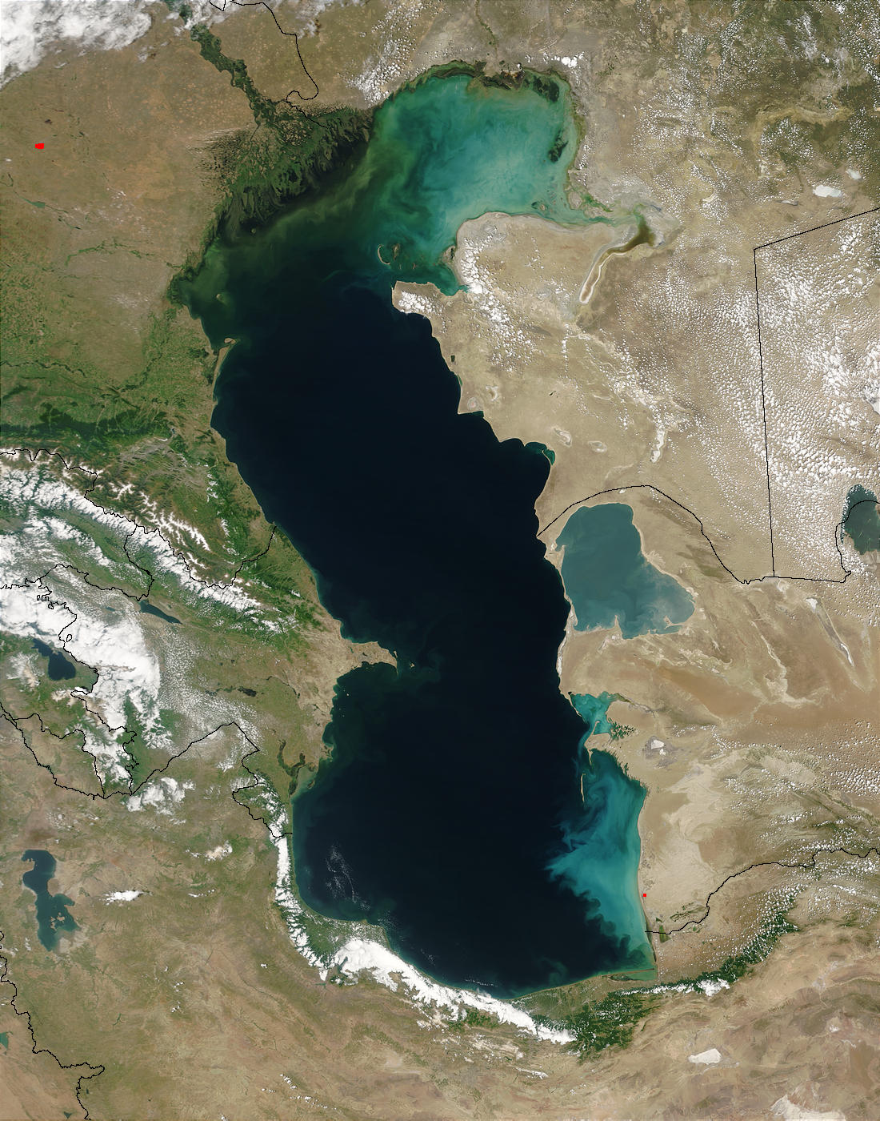
The situation with environment in the Caspian sea region is determined by an increase of the Caspian sea level and anthropogenic impact on the coastal ecosystems

Slide 30
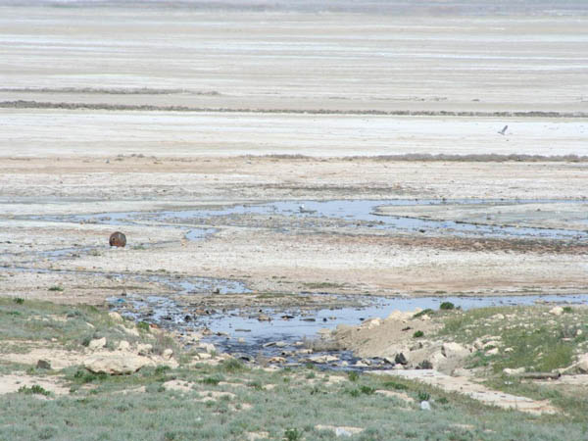
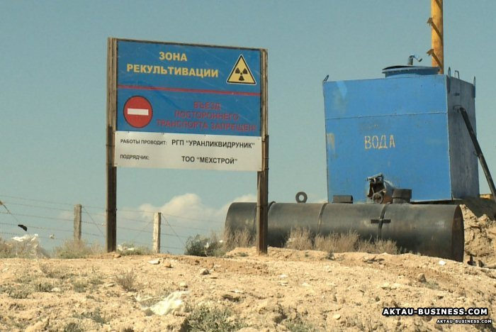
Environmental disaster threatens to Aktau and the Caspian Sea. Factories of the industrial giant Caspian Mining and Metallurgical Combine dumped waste water into the basin located just a few kilometers from the city of Aktau, where the artificial lake was formed Koshkar-Ata.

Slide 31
Aral Sea is the problem not only for Kazakhstan but also for whole world community

Slide 32
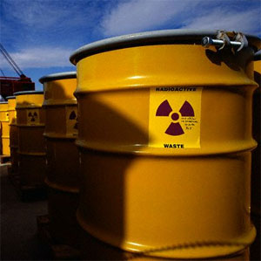


Destroying the environment any modern society destroys its own future

Slide 33

Provision of sustainable development of Kazakhstan.
Sustainable development of country is this development, satisfying the necessities of the real generation and not putting under the threat of possibility of future generations to satisfy the necessities.

Slide 34
The aim of Conception is an achievement of balance of economic, social, ecological and political aspects of development of Republic of Kazakhstan as bases of upgrading of life and providing of competitiveness of country are in a long-term prospect.

Slide 35

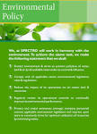
Legislation of the Republic of Kazakhstan on Environmental Protection
1. The objectives of the legislation of the Republic of Kazakhstan on Environmental Protection shall be the regulation of relations in the interaction between society and nature, aimed at the improvement of Environmental Quality, the rational use and renewal of Natural Resources, and the reinforcement of law and order.
2. The legislation of the Republic of Kazakhstan on Environmental Protection shall be based on the Constitution of the Republic of Kazakhstan and shall include this Law, laws on the protection, renewal and use of Natural Resources, and other legislative and normative legal acts.

Slide 36
The protection and use of land, subsoil, water, atmosphere, forests and other flora, fauna, objects of the Environment of special ecological, scientific, and cultural value, and specially protected natural territories not regulated by this Law shall be regulated by the relevant legislative and other normative legal acts of the Republic of Kazakhstan.

Slide 37

Prehistory of creation
The president of our country put an aim of creation to 2010 of basic ecological standards of steady development of society. The first step in this direction was an acceptance in January, 2007 of the Environmental Code of the Republic of Kazakhstan.

Slide 38
This Environmental Code aims to solve the following problems:
generalization and systematization at the legislative level of environmental protection;
raising of status of ecological requirements and norms to the level of legislative acts of direct action;
implementation of international standards in the practice of environmental protection in our country.

Slide 39


Slide 40
Main strategic directions of Kazakhstan to improve the environment
With the purpose of providing sustainable development of the republic of Kazakhstan the following mechanisms were developed:
Financing activities for environmental protection from the state budget, local budgets, funds of subsoil users, international loans and grants and other sources;
To apply the principle of rental payments in taxation of subsoil users ;
Ecological insurance of the environment damage and also establishing foundation to finance activities for restoration of the environments at liquidation of enterprises;

Slide 41
Main strategic directions of Kazakhstan to improve the environment
Introduction of ecological taxes on manufacturing of ecologically hazardous products and services with possible allocation of funds directly to implement large environment- oriented programs;
Establishing and applying the systems of taxes and fees stimulating use of environmentally friendly technologies, goods and services irrespective of the country –manufacturer;
Introducing market mechanisms of the environment protection, including stimulating reuse and reprocessing of industrial goods;

Slide 42

The permit system for pollution of the environment gives an opportunity to regulate contamination of the environment by industrial enterprises

Slide 43
Basic Principles of Environmental Protection
The priority of the protection of the lives and health of people, the preservation and restoration of an Environment favorable for the life, labor, and recreation of the population;
Balanced resolutions of social and economic objectives and problems of the Environment for the purpose of the 'transition of the Republic of Kazakhstan toward stable development under a market economy and meeting the requirements of present and future generations in a healthy and favorable Environment;

Slide 44
The provision of Ecological Safety and restoration of violated natural Ecosystems on territories with an unfavorable ecological situation;
The rational use and renewal of Natural Resources, the gradual introduction of fees for the Use of Resources, and the introduction of economic incentives for Environmental Protection;

Slide 45
ensuring the preservation of biological diversity and environmental objects of special ecological, scientific, and cultural value;
state regulation and state control over the inevitability of liability for violations of environmental legislation;
the prevention of damage to the Environment and assessment of any possible effect on the Environment;

Slide 46
the active and democratic participation of the population, public associations, and local self-administrating agencies for Environmental Protection; and
international cooperation in Environmental Protection on the basis of international law.

Slide 47

CONCLUSION
The future is in our hands. Significant efforts are required to come to a new quality of life, safety for humans and the confidence to think about the future of our children and the preservation of the natural environment. We have to fight for our healthy environment.

Slide 48
Recommended literature:
Y.Shokamanov, A.Makazhanova et al. Human Development in Kazakhstan. UNDP Kazakhstan. Chrestomathy. Almaty: S-Print. 2006
Y.Shokamanov, A.Makazhanova et al. Human Development in Kazakhstan. UNDP Kazakhstan. Workshop. Almaty: S-Print. 2006
A.Bigaliev,M.F.Khalilov,M.A.Sharipov. The Basis of General Ecology. Almaty. Kazakh university, 2007
S.Z.Kolumbaeva.R.M.Baldebaeva. General Ecology. Almaty, Kazakh university, 2006.
Reports of the PK Ministry of Environmental Protection On the State of the Neutral Environment 2000-2007.
The Concept of Ecological Education in the Republic of Kazakhstan. Astana. 2002
The Concept of Ecological Education in the Republic of Kazakhstan. Astana. 2002
Environmental Code of the Republic of Kazakhstan. Astana. 2007

